Slide 1
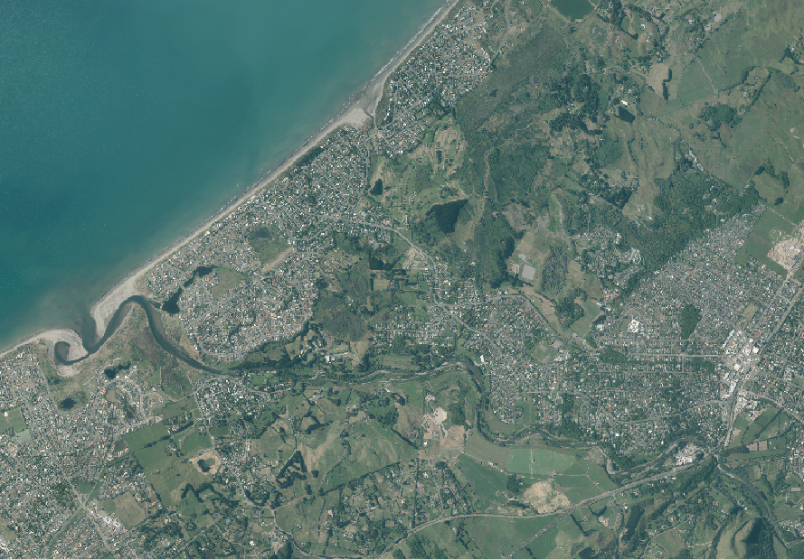

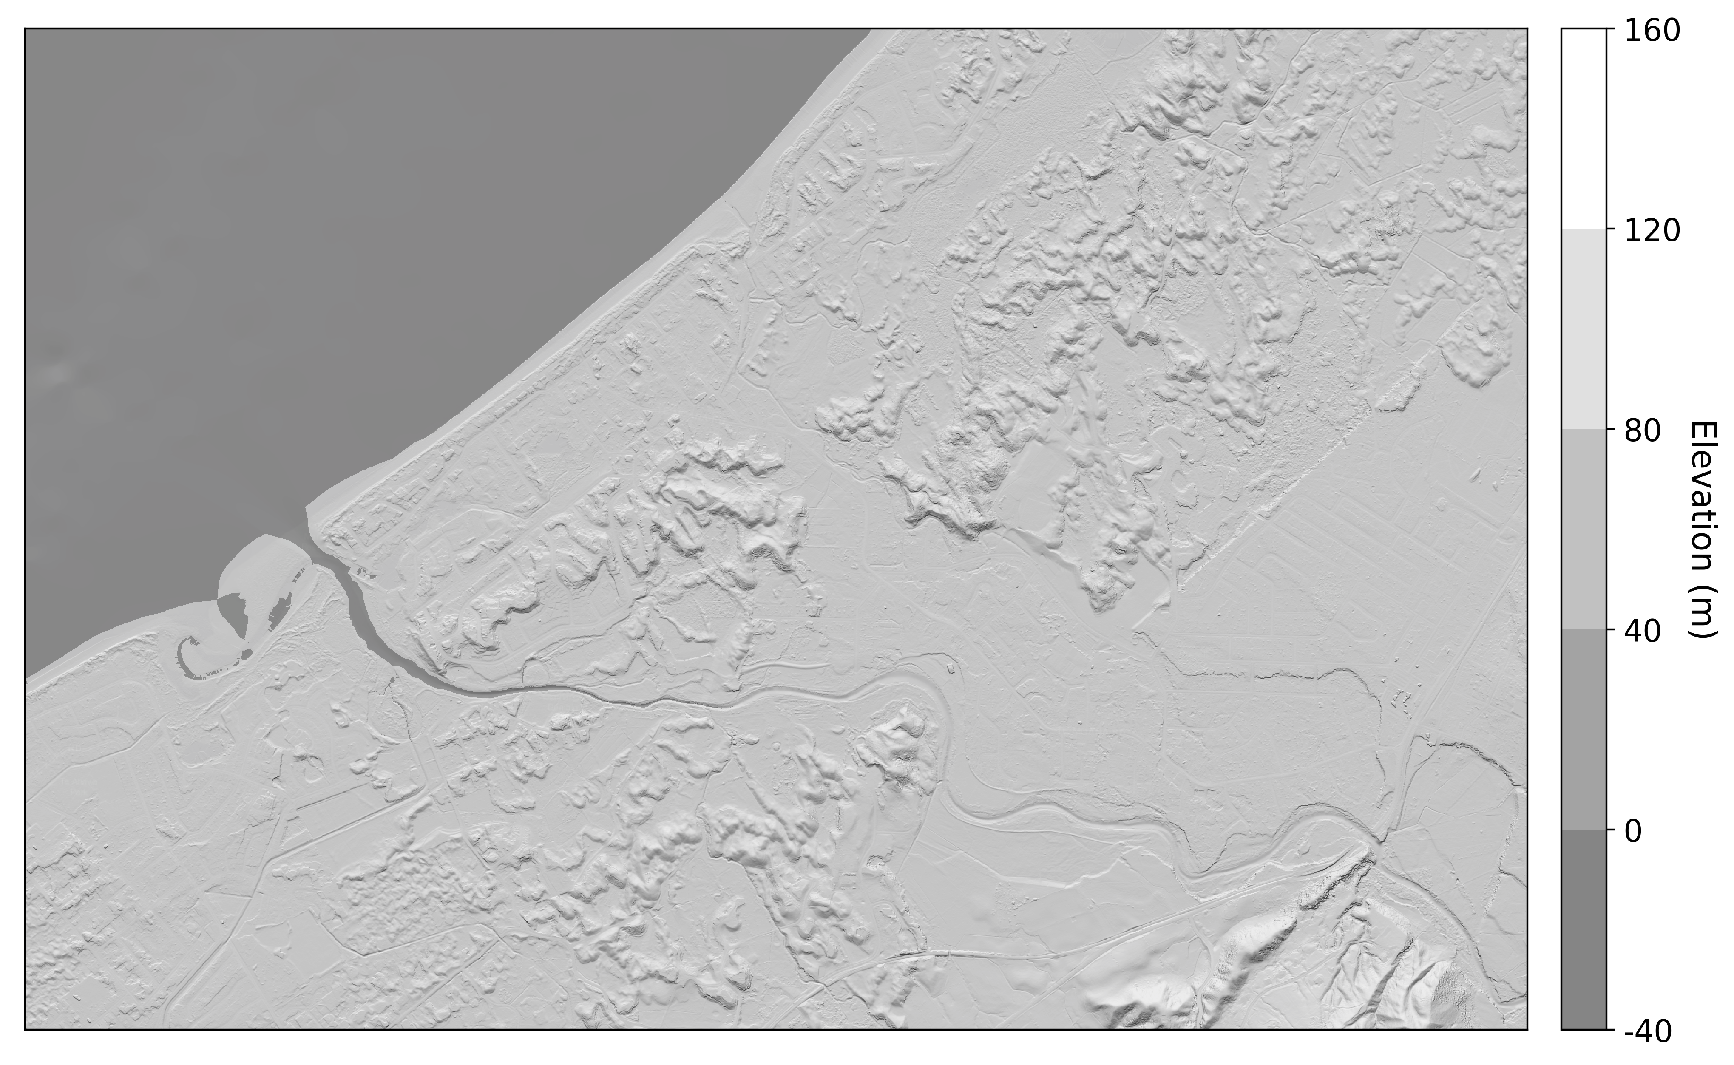
b)
a)
c)

Slide 2
(a)
(b)
(c)

Slide 3
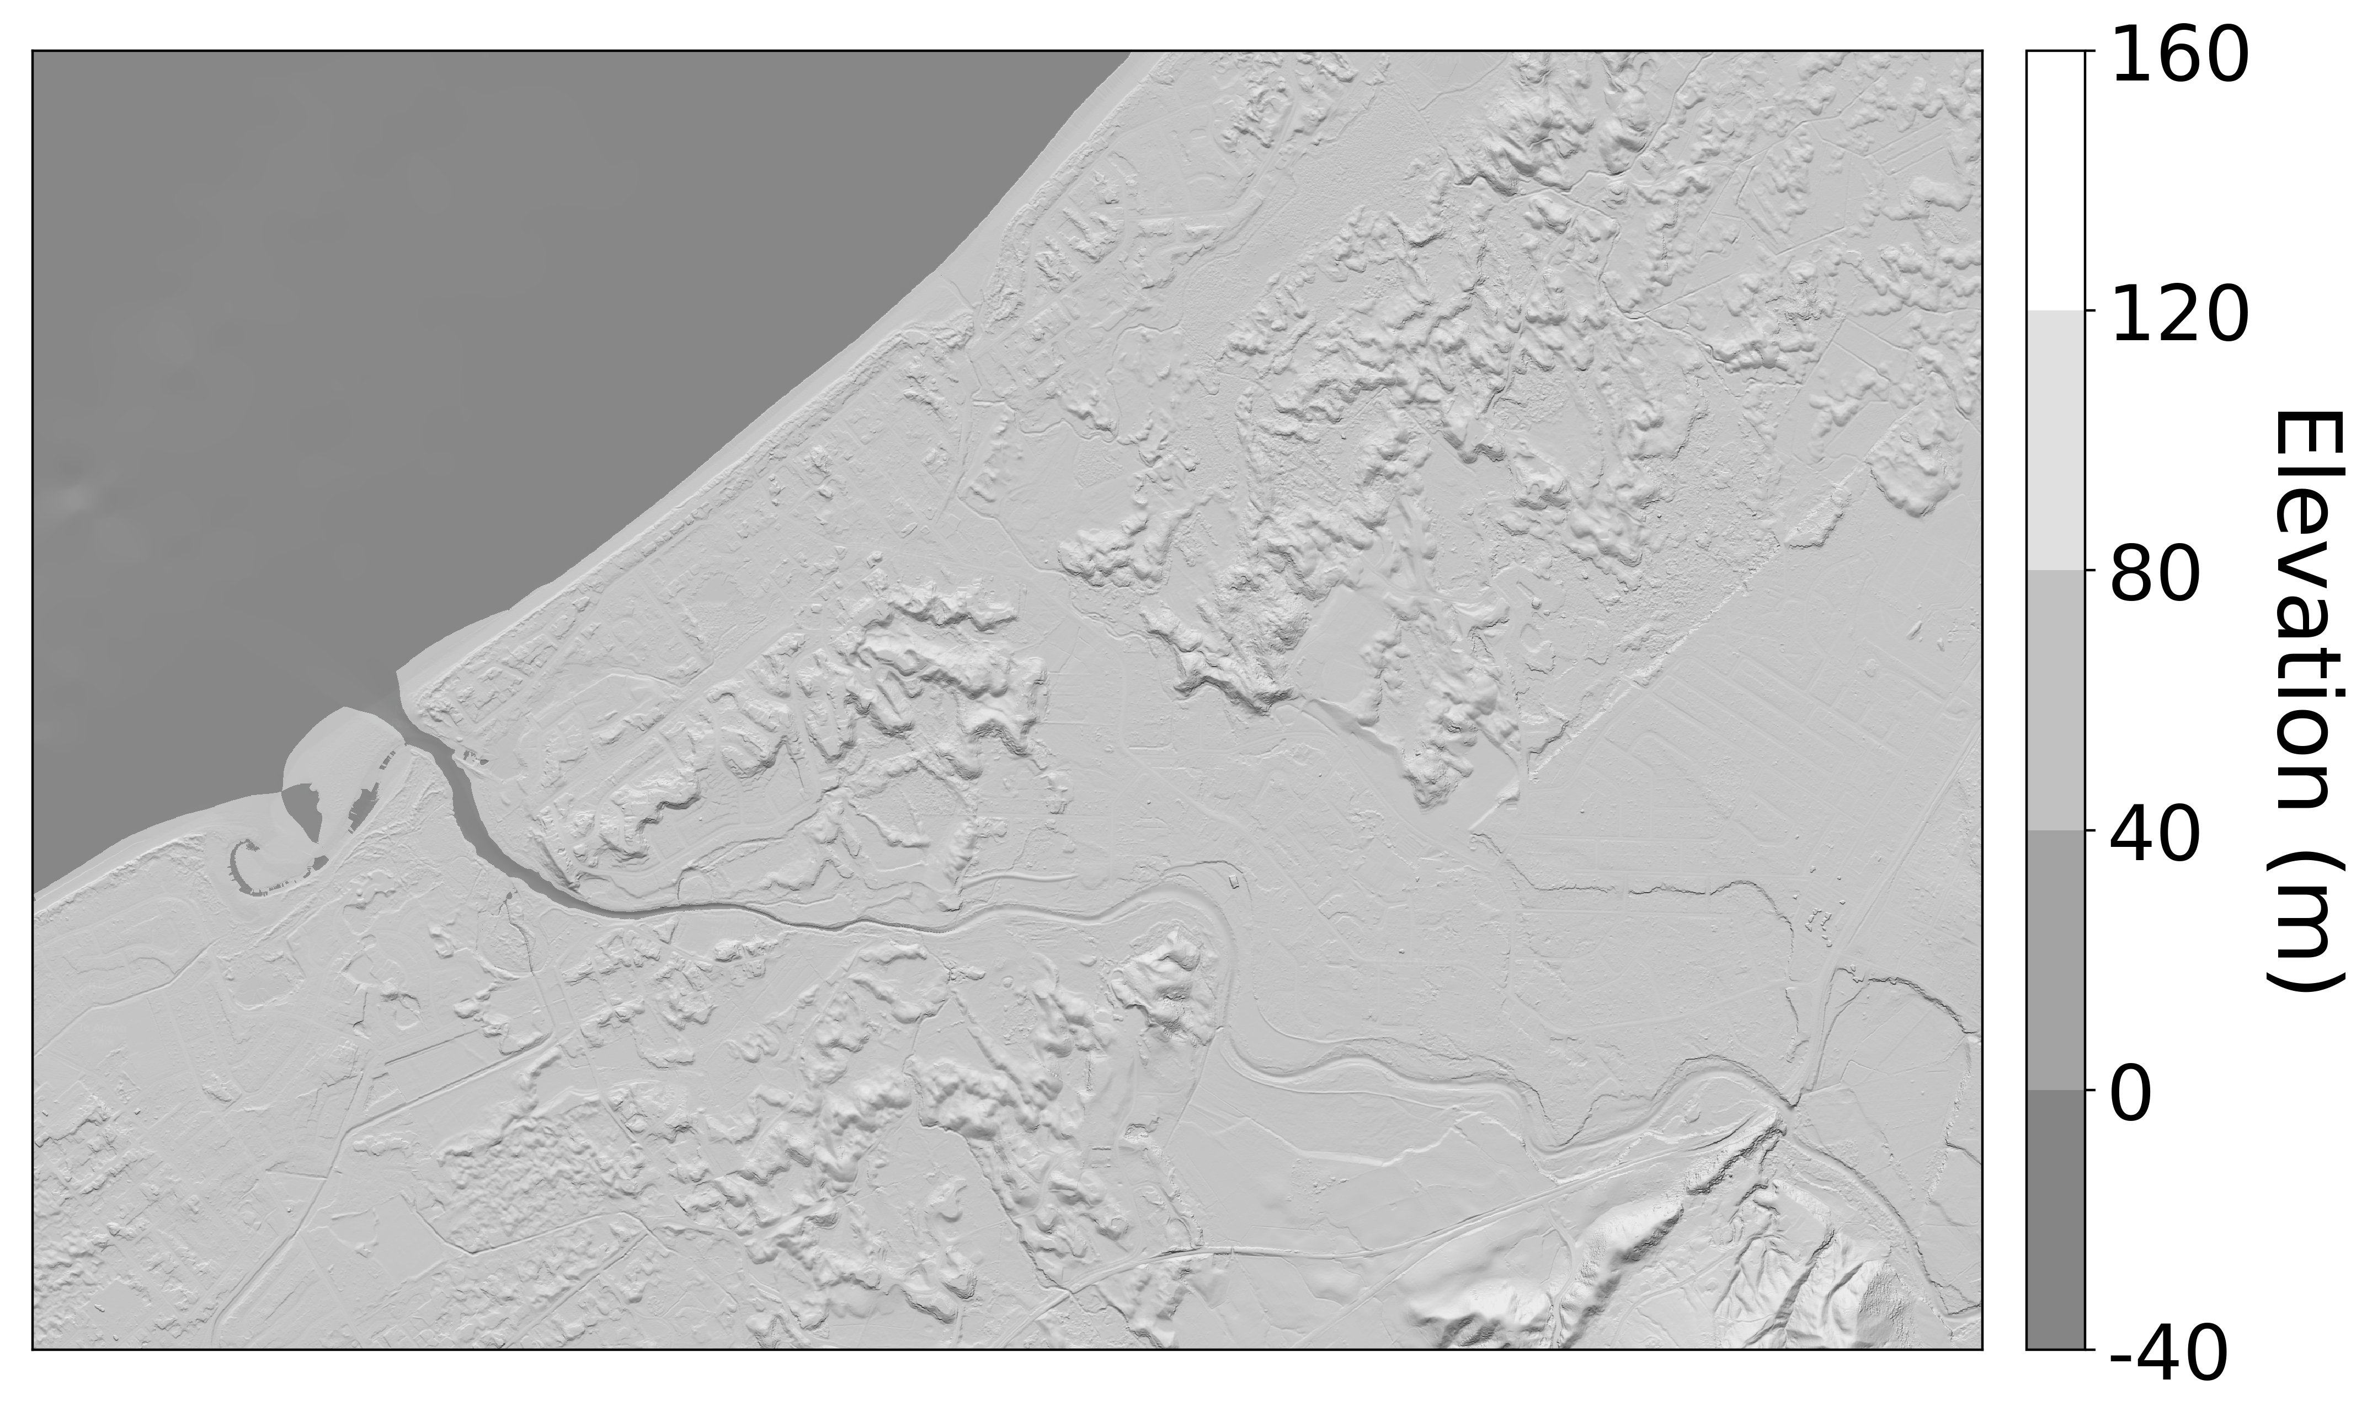
(a)
(b)
(c)

